Slide 1
Capstone Engagement
Assessment, Analysis, and Hardening of a Vulnerable System

Slide 2
Table of Contents
This document contains the following sections:
01
Network Topology
02
Red Team: Security Assessment
03
Blue Team: Log Analysis and Attack Characterization
Hardening: Proposed Alarms and Mitigation Strategies
04

Slide 3
Network Topology
3

Slide 4
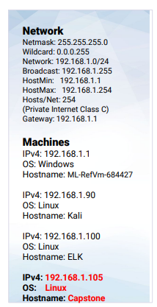
Network Topology
Network
Address Range:
Netmask:
Gateway:
Machines
IPv4:
OS:
Hostname:
IPv4:
OS:
Hostname:
IPv4:
OS:
Hostname:
IPv4:
OS:
Hostname:

Slide 5

Red Team
Security Assessment
5

Slide 6
Recon: Describing the Target
Nmap identified the following hosts on the network:
Hostname | IP Address | Role on Network
CAPSTONE | 192.168.1.105 | WEB Server
ELK | 192.168.1.100 | SIEM System
ML-RefVm-684427 | 192.168.1.1 | Default Gateway
Kali | 192.168.1.90 | Attacking Virtual Machine

Slide 7
Vulnerability Assessment
The assessment uncovered the following critical vulnerabilities in the target:
Vulnerability | Description | Impact
The directory listing is widely available on the Apache Web Server | Anyone can use the browser to navigate contents of directories on Capstone Apache web server | Attackers immediately know what folders are available, which have employees names and other useful information in beginning an attack.
There is no failed password lockout, which allows attackers to enter passwords until they access the system. There is not password criteria, allowing weak password names | We quickly found the password using ‘rockyou”. We were never locked out for failed login attempts allowing brute force attack. | An attacker has no problem getting credentials to penetrate the system.
There is Persistent Reverse Shell Backdoor, which means the root directory can be accessed by the attacker. | Reverse shell payloads can be exploited on the web server as IPS/IDS/Firewall(s) allow outbound ports and undetected reverse shell. | Capstone Apache web Server has reverse backdoor shell access.

Slide 8
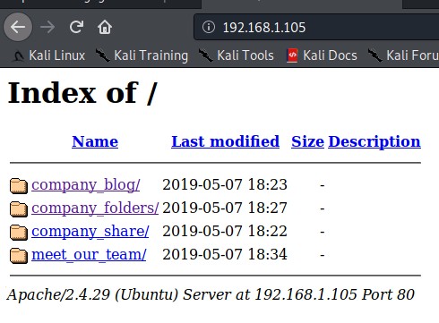
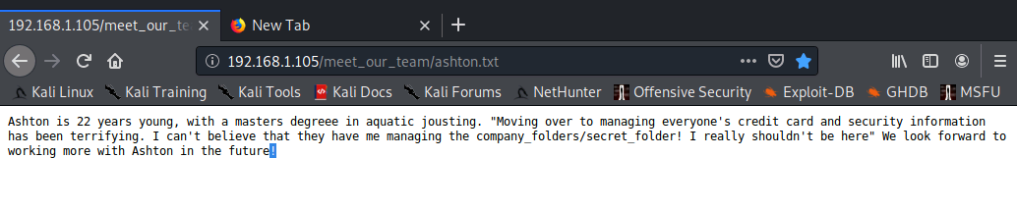
Exploitation: : Directory Listing Enabled on Apache
01
02
03
First we navigate with Firefox to 192.168.1.105/ and find the Apache Server index of the company folders. Inside the folders are the employee names and roles, exposing which employees many have excessive privileges.
After searching the company folders, we read the company blog which introduces us to Ashton and his position indicated excessive privilege. When then navigate to Ashton’s folder and find out he is responsible for the folder /company_folders/secret_folder/

Slide 9
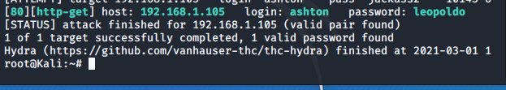
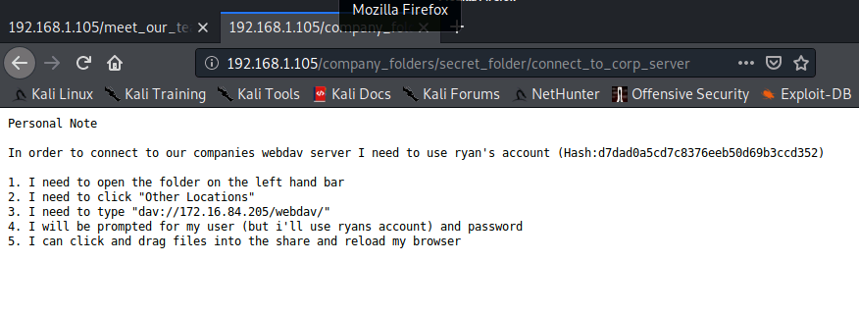
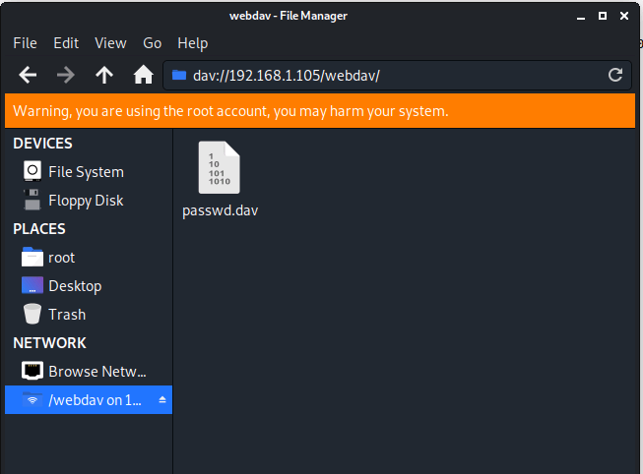
Exploitation: Weak Password & No Failed Password Lockout
We use Hydra brute force
attack to get the password for Ashton’s account.
Password for Ashton was “leopoldo”
found in ‘rockyou’ dictionary.
We log into 192.168.1.105/company_folders/secret_folder
Ashton’s credentials.
We are then able to access /secret_folder/.
Secret folder gives us access info for /webdav/
system.
Secret folder has the hash for Ryan’s password, we cracked the hash and reveal the password “linux4u” allowing
us access to webdav.

Slide 10
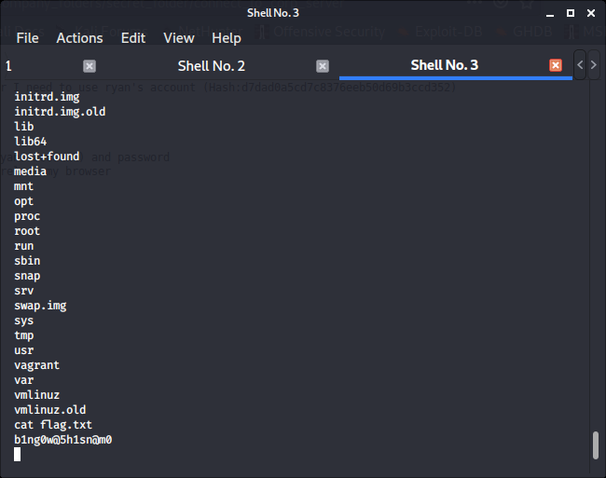
Exploitation: Persistent Reverse Shell Backdoor
01
02
03
Using msfvenom payload we establish a remote listener and execute a reverse shell backdoor on the Apache server of the victim machine
Now that we have opened a remote backdoor, we gain access to the root directory on the victim machine.
In doing so we are able to search the director and capture the flag file.

Slide 11

Blue Team
Log Analysis and Attack Characterization
11

Slide 12

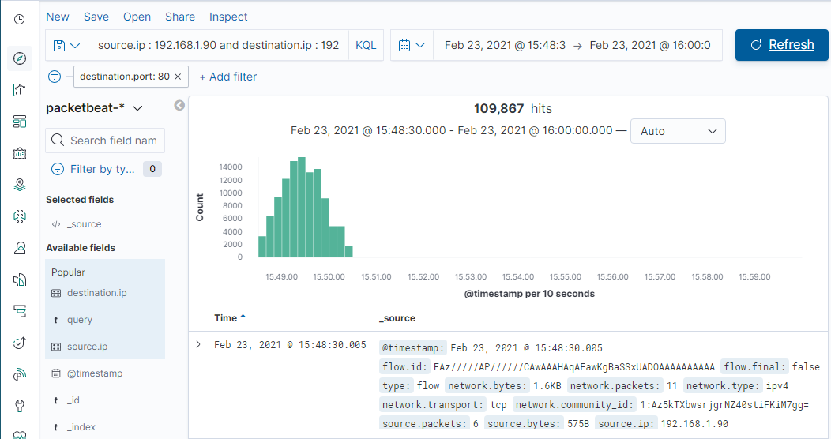
Analysis: Identifying the Port Scan
What time did the port scan occur? Port scan occurred at 15:48:26.00 on February 23, 2021.
How many packets were sent, and from which IP? There were 109, 867 packets sent.
What indicates that this was a port scan? Since multiple ports were requested simultaneously from the same ip address, this indicates it was a port scan.

Slide 13
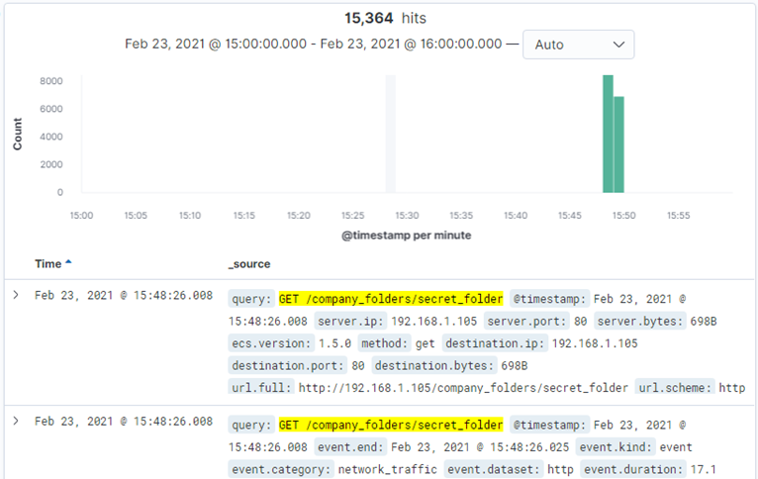
Analysis: Finding the Request for the Hidden Directory
What time did the request occur? 15:48:26 February 23, 2021
How many requests were made? 15, 364
Which files were requested? company_folders/secret_folder
What did they contain? Hash code password for user Ryan

Slide 14
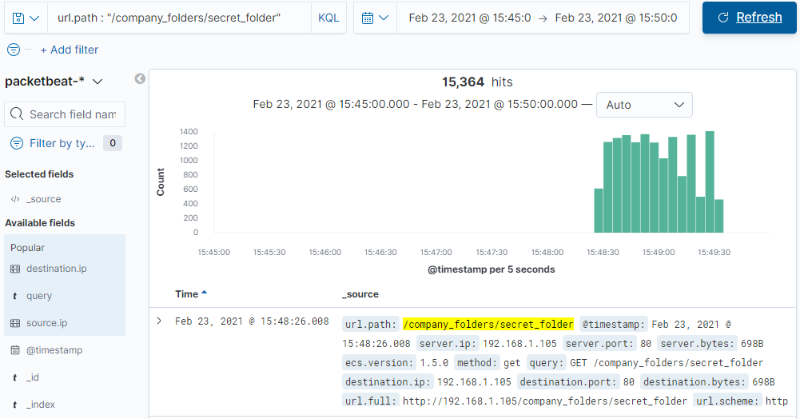
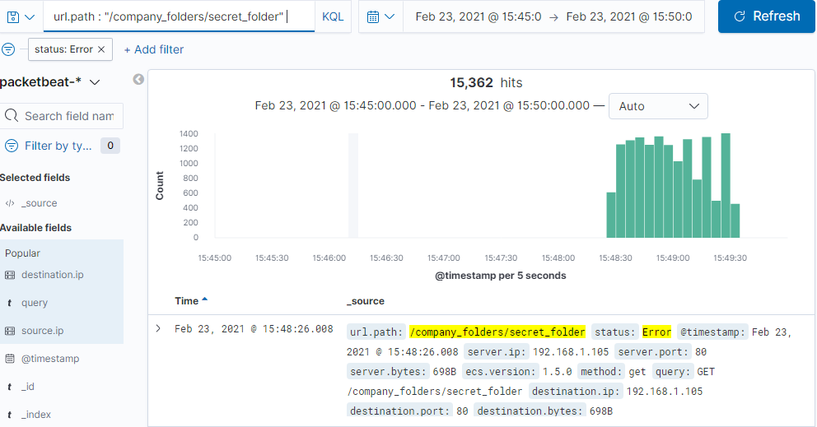
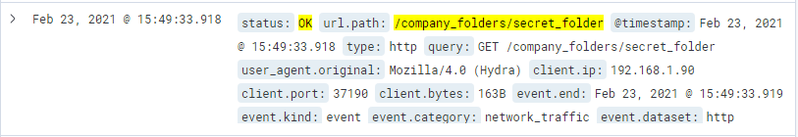
Analysis: Uncovering the Brute Force Attack
Answer the following questions in bullet points under the screenshot if space allows. Otherwise, add the answers to speaker notes.
How many requests were made in the attack? 15, 364
How many requests had been made before the attacker discovered the password? 15,362

Slide 15
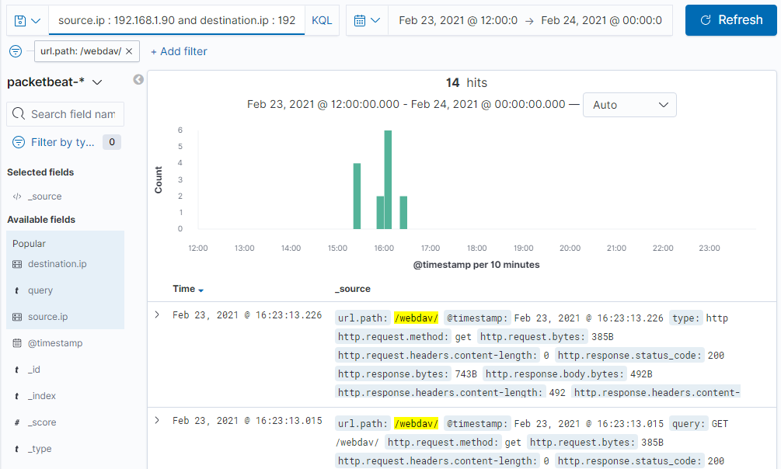
Analysis: Finding the WebDAV Connection
How many requests were made to this directory?
There were 14 requests made to WebDav directory
Which files were requested?
/webdav/ /webdav/shell.php/ and /webdav/passwd.dav

Slide 16
Blue Team
Proposed Alarms and Mitigation Strategies
16

Slide 17
Mitigation: Blocking the Port Scan
We suggest an alarm to detect future port scans:
Search criteria:
destination.ip: 192.168.1.105 and source.ip: (not
192.168.1.105) and destination.port: (not 443 or 80)
Report criteria:
Number of ports accessed per source IP per second.
Alarm criteria/threshold:
Alert email and log when > 3 none port 403 or port 80 scans detected at the same timestamp from the same IP occur.
In this case were going to recommend IPtables/Firewall port blocking and scan delays to prevent future portscans.
Kibana or Splunk can be used to send alerts of multiple port access coming simultaneously from a single source ip and prepare a response to the potential threat.

Slide 18
Mitigation: Finding the Request for the Hidden Directory
An alarm set to expose future unauthorized access:
Search criteria:
source.ip: (not 192.168.1.105 or 192.168.1.1) and url.path :
*secret_folder*
Report criteria:
Number of times “secret_folder” accessed from external IP
Alarm criteria/threshold:
Alert email and log when > 0 access is detected on
“secret_folder” from IPs other than 192.168.1.105 or
192.168.1.1.
What configuration can be set on the host to block unwanted access?
The configuration file will be modified to prevent unauthorized access to the “secret_folder”.
Open your httpd.conf file:
nano /etc/httpd/conf/httpd.conf * Locate directory section (/var/www/) and set it as follows:
Order allow,deny
Allow from 192.168.1.1
Allow from 192.168.1.105
Allow from 127
Deny from 192.168.1.90
</Directory>

Slide 19
Mitigation: Preventing Brute Force Attacks
The following alarm can be set to detect future brute force
attacks:
Search criteria:
http.request.method : "get" and user_agent.original
:"Mozilla/4.0 (Hydra)" and url.path
:"/company_folders/secret_folder/" and status :(Error or
OK)
Report criteria:
Number of times Error (401) response detected in 10
second interval.
Alarm criteria/threshold:
Alert email and log when, on protected files and folders, > 5
Error (401) responses occur at any time OR any OK (200)
responses occur from non-trusted IPs
What configuration can be set on the host to block brute force attacks?
A strong password policy is an essential mitigation strategy, one that can’t be penetrated by a brute force attack.
Locking out the user after multiple failed logins will also prove to be an effective mitigation strategy.
Multi layered login, send a success (200) response for a failed
password and forward the user to try again on a second login
page.
Security questions and CAPTCHA will ensure that the user is human and not a system attack.

Slide 20
Mitigation: Detecting the WebDAV Connection
The following alarm can be set to detect future
unauthorized access to this directory::
Search criteria:
http.request.method : * and url.path: *webdav* and
source.ip: (not 192.168.1.150 or 192.168.1.1)
Report criteria:
Number of times the directory is requested from
non-trusted IPs.
Alarm criteria/threshold:
Alert email and log when requests are made, on protected
files and folders, from non-trusted IPs
What configuration can be set on the host to control access?
> nano /etc/httpd/conf/httpd.conf
Navigate to the following directory:
<Directory /var/www/webdav/>
Order allow,deny
Allow from 192.168.1.1
Allow from 192.168.1.105
Allow from 127
Deny from all
</Directory>

Slide 21
Mitigation: Identifying Reverse Shell Uploads
The following alarm can be set to detect future
unauthorized file uploads:
Search criteria:
http.request.method : “put” and url.path: *webdav* and
source.ip: (not 192.168.1.1 or 192.168.1.105)
NOTE: Also Reverse Shell Signature for Consideration of
Reverse Shell Detection:
source.ip: 192.168.1.105 and destination.ip: (not 192.168.1.1
or 192.168.1.105) and destination.port > 0 and
network.protocol: (not *) and http.response.body.bytes: (not
*) and source.port: (not 80 or 22)
Report criteria:
Count directory “put” method from non-trusted IPs.
Alarm criteria/threshold:
Alert email and log when “put” request methods are made,
on protected folders, from non-trusted IPs
What configuration can be set on the host to block file uploads?
<Directory /var/www/webdav/>
Order allow,deny
Allow from 192.168.1.1
Allow from 192.168.1.105
Allow from 127
Deny from all
<LimitExcept GET POST HEAD>deny from all
</LimitExcept>
</Directory>

